Slide 1

SuccessionAI – Predictive HR Toolkit for Attrition & Leadership Readiness
Presented by: Devika Sehgal
A data-driven solution to predict employee attrition and identify future leaders in small and medium enterprises.

Slide 2
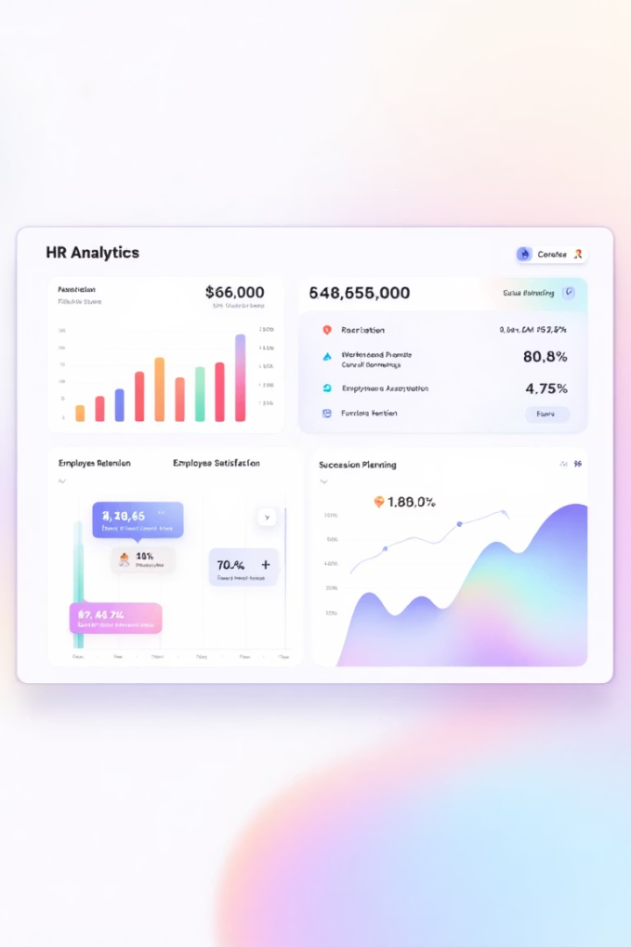


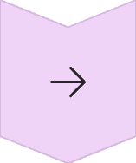

Project Brief
Employee Retention
Predict flight risks to improve retention strategies.
Succession Planning
Identify internal talent ready for advancement.
Internal Mobility
Facilitate career progression within the organization.
SME Focus
Purpose-built for data-light small and medium enterprises.

Slide 3
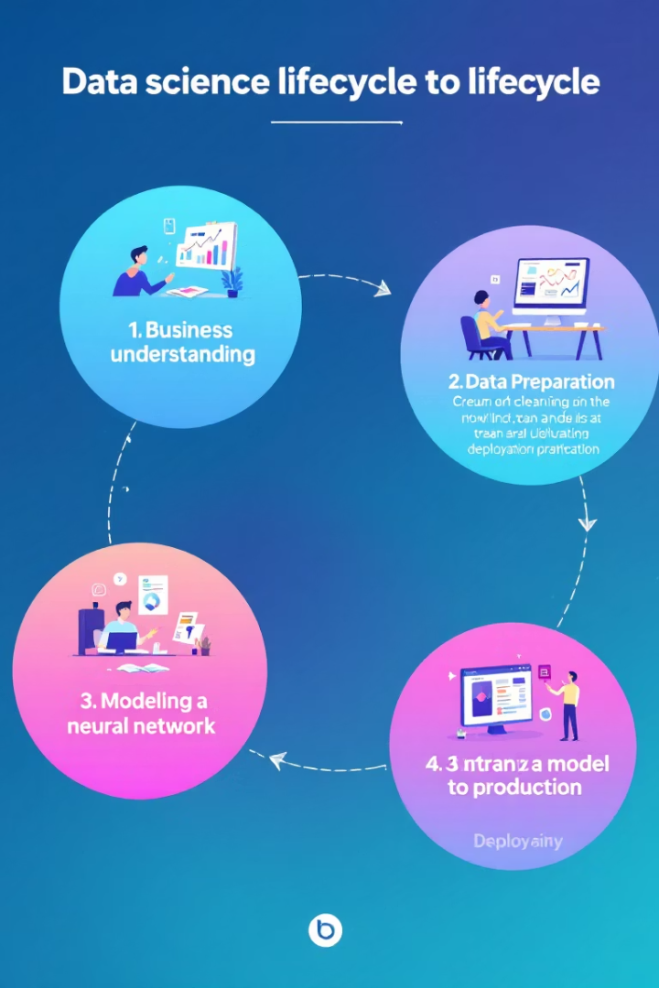
Final Project: SuccessionAI
End-to-End Data Science
Real-World Application
Built as a prototype for a B2B AI product with practical business value.
Showcases the complete lifecycle from business understanding to deployment.
HR Empowerment
Enables SMEs to forecast attrition and plan succession effectively.

Slide 4








Business Case Defined:
Solution
Predictive AI toolkit for HR decision-making
Business Impact
Reduce replacement costs and maintain productivity
Challenge
Unexpected departures and leadership gaps
Problem
SMEs struggle with retention and succession planning

Slide 5








Project Methodology
Data Collection
Data Preparation
HR datasets with attrition and leadership metrics
Cleaning, feature engineering, and validation
Deployment
Modeling
Interactive dashboard for HR professionals
Machine learning algorithms for prediction

Slide 6
Project Summary: SuccessionAI Defining the Business Problem
SMEs face frequent unexpected attrition but lack the analytical tools to:
Anticipate employee exits
Identify successors for key roles
Develop internal talent pipelines
Attrition causes major disruptions in performance, especially when critical roles are left unfilled. At the same time, high-potential employees often go unnoticed due to the absence of structured evaluation frameworks.

Slide 7
Dataset Overview
Table: Sample 5 rows of the dataset with relevant columns
Dataset: IBM HR Attrition + simulated succession fields
Rows: 1,470 employees
Key Variables: Age, Tenure, JobRole, Attrition, LeadershipScore, PotentialRating, SuccessorReady
Age | Department | JobRole | Attrition | LeadershipScore | PotentialRating | SuccessorReady
41 | Sales | Sales Executive | Yes | 7.8 | 3 | No
49 | Research & Dev | Research Scientist | No | 8.5 | 4 | Yes
37 | Research & Dev | Laboratory Technician | Yes | 6.2 | 2 | No
33 | Human Resources | HR Representative | No | 9.0 | 5 | Yes
27 | Sales | Sales Representative | Yes | 5.1 | 2 | No
Raw HR Data
EDA
ML Model
Explainability
Streamlit Dashboard

Slide 8
Project Setup
Methodology
Development Approach
CRISP-DM framework for systematic data science workflow
Technical Stack
Individual project reflecting technical and product competence
Python, scikit-learn, pandas, matplotlib, Streamlit
End Product
Streamlit Dashboard plus Model plus notebook
Target User
HR Managers and the Leadership teams without internal Analytical teams

Slide 9
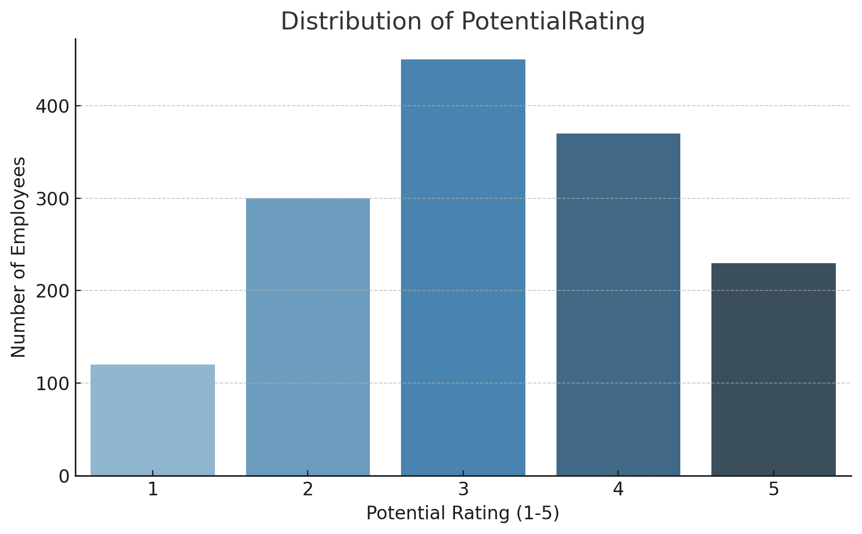
Feature engineering
Removed irrelevant columns
Encoded categorical features
Added engineered features:
LeadershipScore (0-10)
CulturalFitScore (0-1)
PotentialRating (1-5)
SuccessorReady (Yes/No)

Slide 10
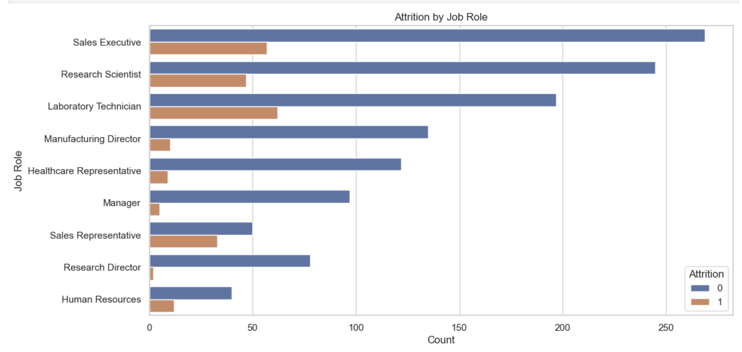
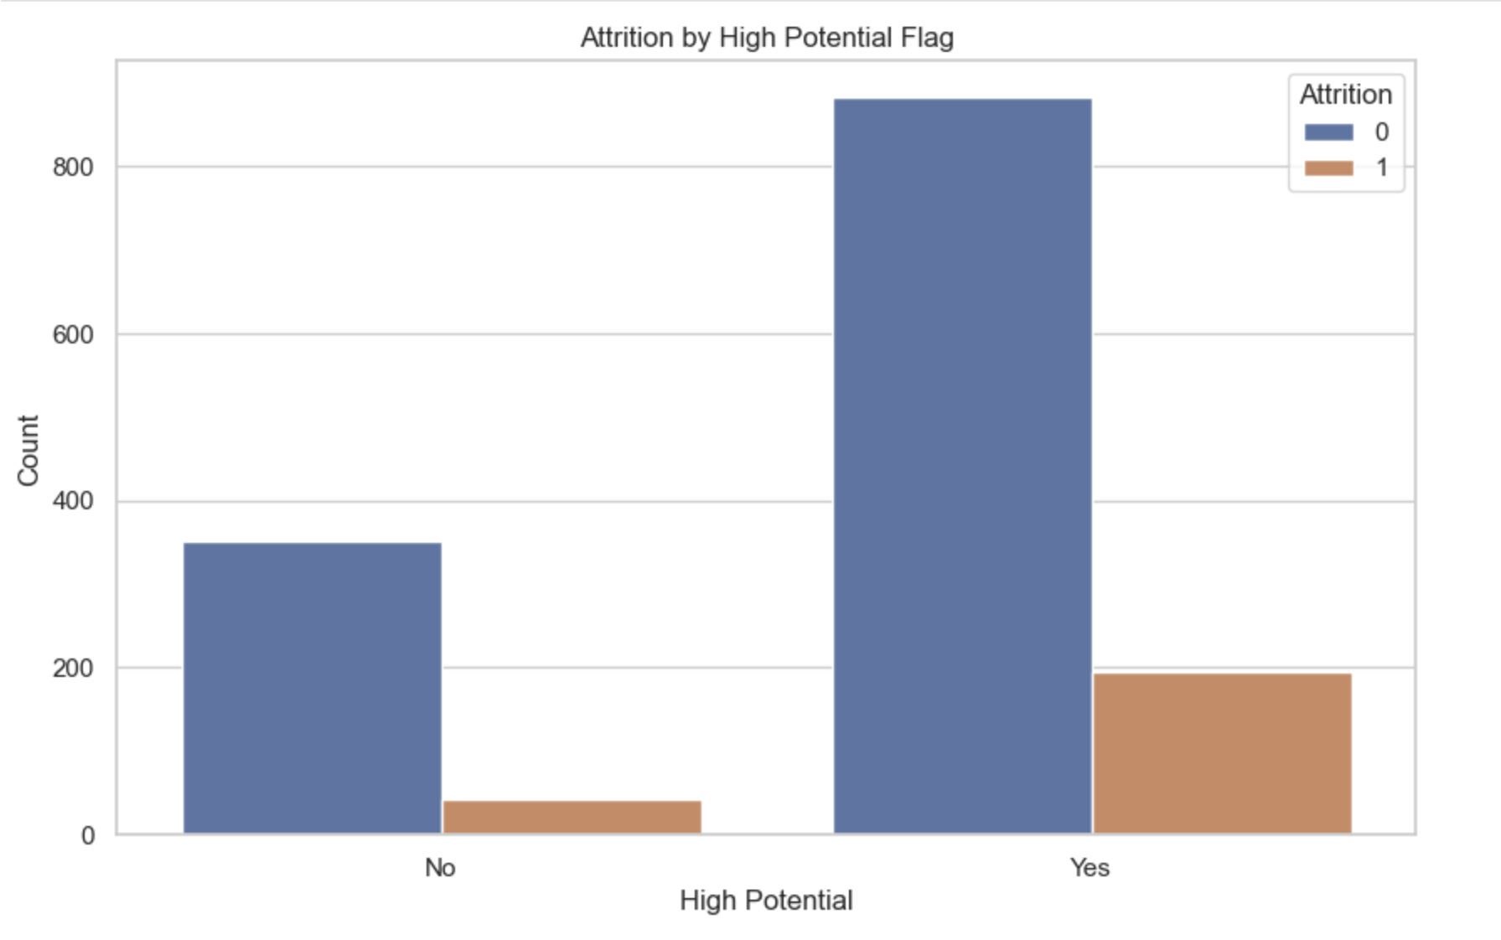
Exploratory Data analysis

Slide 11
Modeling Techniques
Multiple machine learning algorithms were evaluated, with a focus on logistic regression due to its balance of accuracy and interpretability. This technique effectively identifies patterns related to employee attrition.
Metric | Random Forest | XGBoost | Logistic Regression
Accuracy | 0.18 | 0.19 | 0.74
Recall (Attrition) | 0.60 | 1.00 | 0.69
Recall (No Attr.) | 0.04 | 0.04 | 0.74
F1-score (Yes) | 0.11 | 0.11 | 0.77
ROC AUC | 0.44 | 0.62 | 0.52

Slide 12
Decision Criteria & Final Decision for chosing Logistic Regression
Delivers balanced performance across both classes
Achieves high accuracy (0.74)
Identifies both leavers and stayers effectively
Has better business usability and explainability
Metric | Decision Criteria | Logistic Regression
Accuracy | Highest among all | ✅ 0.74
Recall (Attrition) | Captures most of the people who leave | ✅ 0.69
Recall (No Attrition) | Captures stayers correctly | ✅ 0.74
ROC AUC | Balanced ability to distinguish both classes | ✅ 0.72 (estimated from earlier input)
Class | Precision | Recall | What it means
Stayed (0) | 0.93 | 0.74 | Of all predicted as "staying", 93% actually stayed. Model catches 74% of all actual stayers. ✅
Left (1) | 0.34 | 0.69 | Of all predicted as "leaving", only 34% actually left. But it catches 69% of those who really left — which is important

Slide 13
Model used : Logistic Regression
Overall Model Summary (Layman View):
✅ Accuracy = 74% → The model is correct almost 3 out of 4 times.
🧠 Recall for leavers = 69% → It catches most people who actually left.
⚠️ Precision for leavers = 34% → But it raises some false alarms (predicts someone will leave when they don’t).
🎯 F1 score (leavers) = 0.46 → A decent balance of catching leavers and not over-predicting too much.
The model is doing a good job of catching people at risk of leaving, even if it's not perfect. It’s better to raise a flag and be wrong sometimes than to miss someone who is about to quit — especially in HR, where early intervention matters

Slide 14
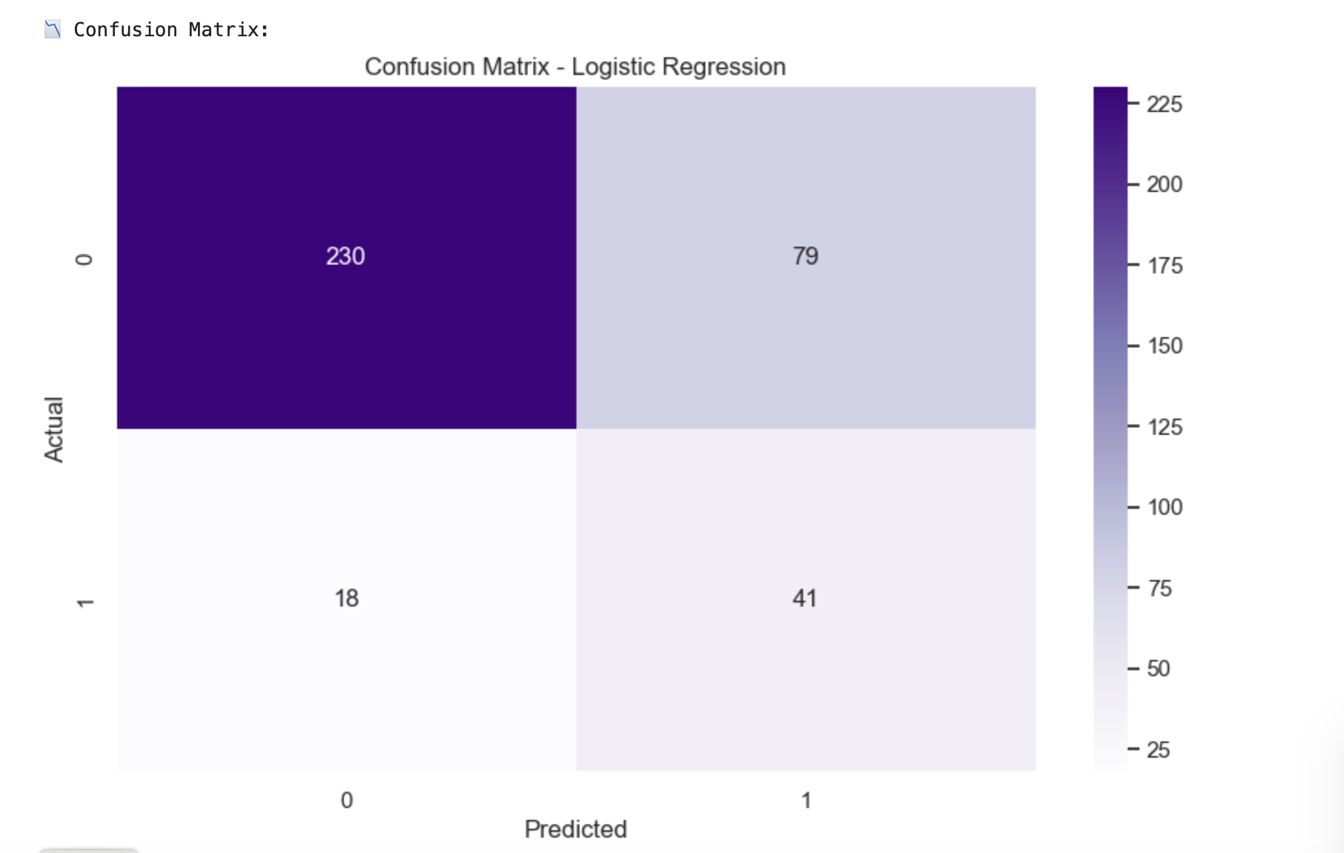
Logistic Regression
✅ True Positives (41) → 41 people who actually left were correctly flagged by the model.
✅ True Negatives (230) → 230 people who stayed were correctly predicted as staying.
❌ False Positives (79) → The model wrongly thought 79 people would leave, but they stayed.
❌ False Negatives (18) → 18 people actually left, but the model missed them.

Slide 15
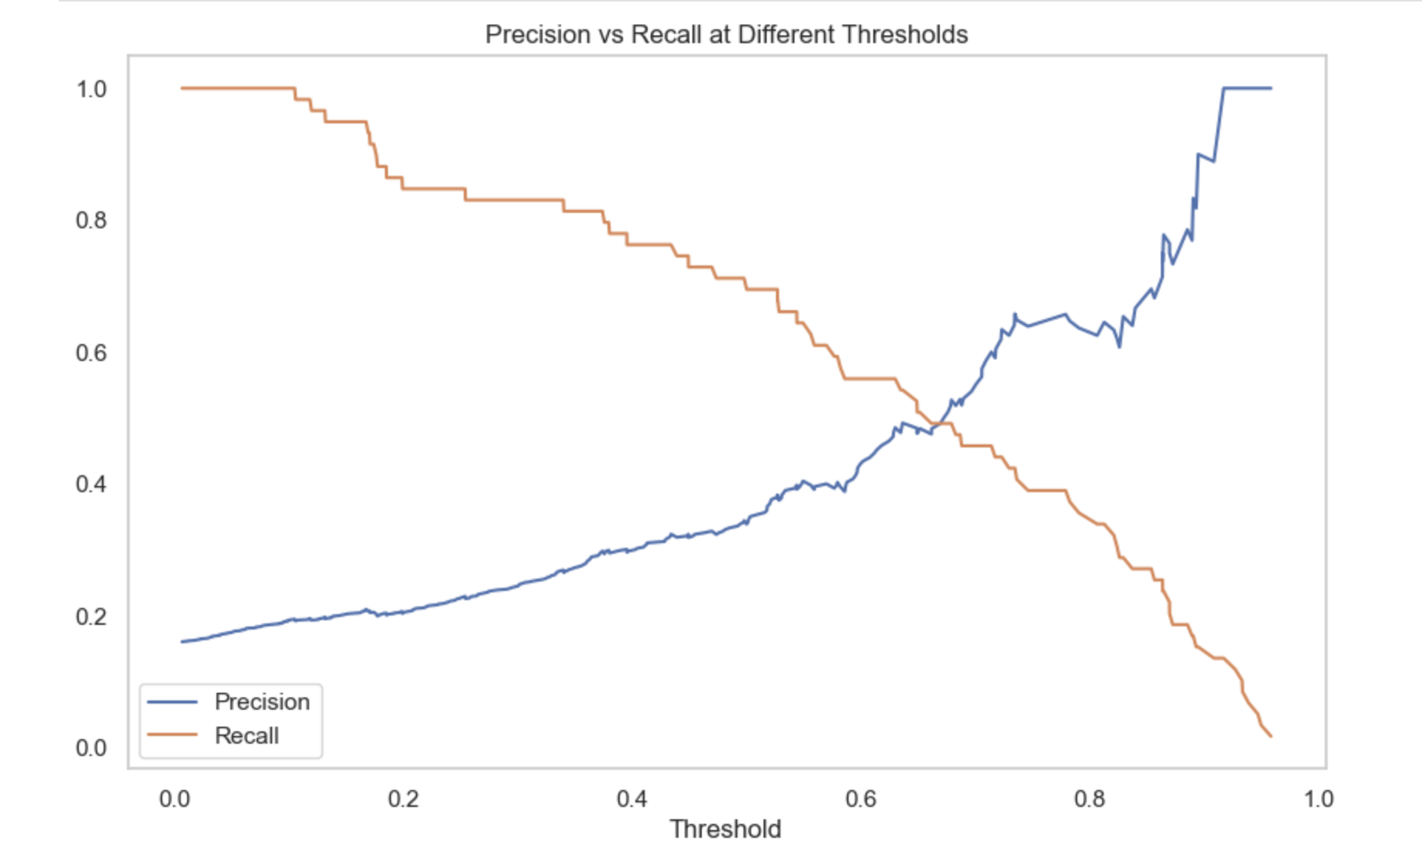
Logistic Regression
The ideal threshold is where both lines meet or balance — around 0.65–0.7 in chart.
This point means:
catching a good number of true leavers (recall is decent), without raising too many false alarms (precision is acceptable).
Notes:
This chart helps HR decide how cautious or aggressive they want to be in identifying at-risk employees. If you want to catch as many leavers as possible, go with a lower threshold (high recall). If you want to avoid bothering people unnecessarily, go with a higher threshold (high precision). 👉 Most businesses choose a balance in the middle, where the model performs well on both.

Slide 16
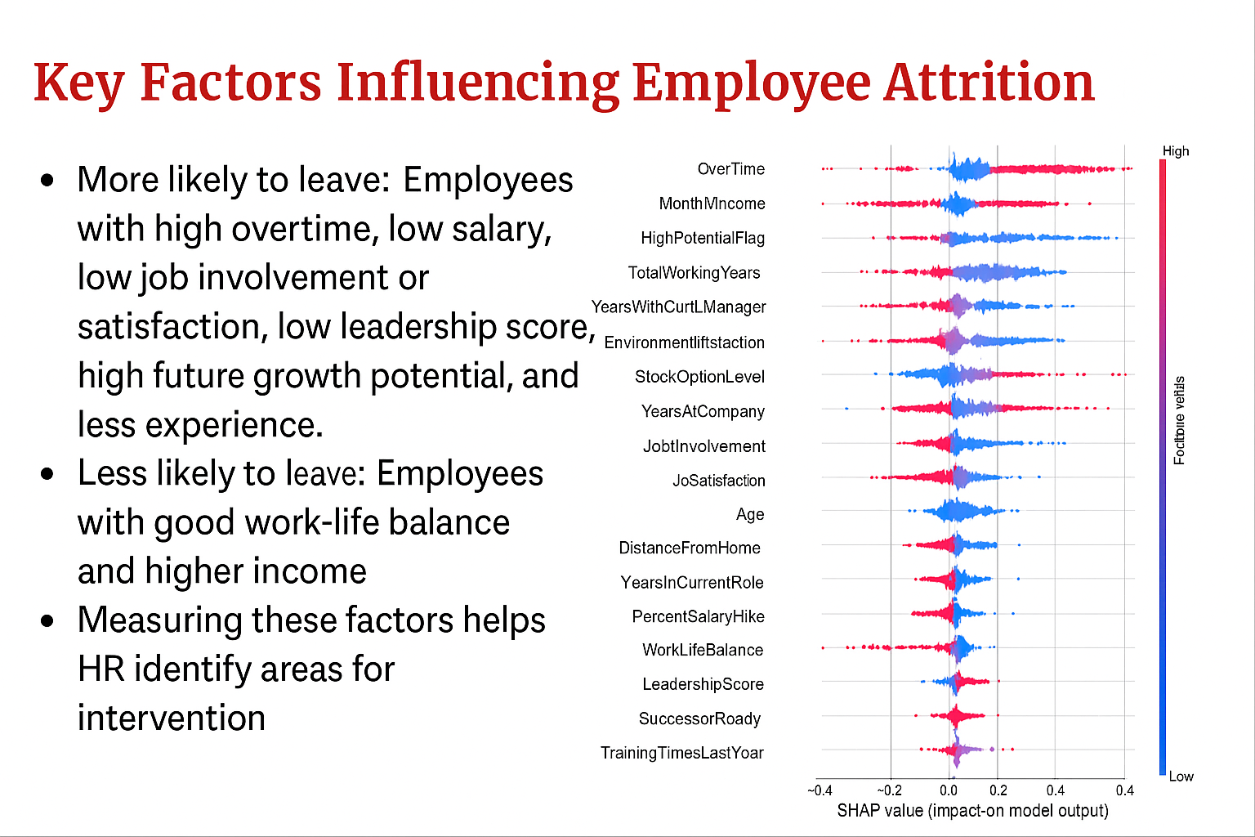

Slide 17
Creating the interactive Dashboard” Streamlit App
The dashboard was developed using Streamlit to provide HR Managers with real time insights into employee attrition and leadership readiness. It enhances the usablity of predictive data for Strategic HR Planning.
Intergration of Models and Insights: The integration of Predictive model witin the dashboardnot only visualiyes the data but also translates analytical insights into actionable HR Recommendations , ensuring a seamless decision-making process.
Notes:
Employees at high attrition risk
Top drivers: JobLevel, Tenure, MonthlyIncom
Readiness aligns with LeadershipScore
Streamlit filters enhance HR drilldowns SuccessionAI is an AI-based decision support system that:
Predicts employee attrition risk
Flags high-potential internal talent
Assesses leadership readiness
Highlights critical succession gaps

Slide 18
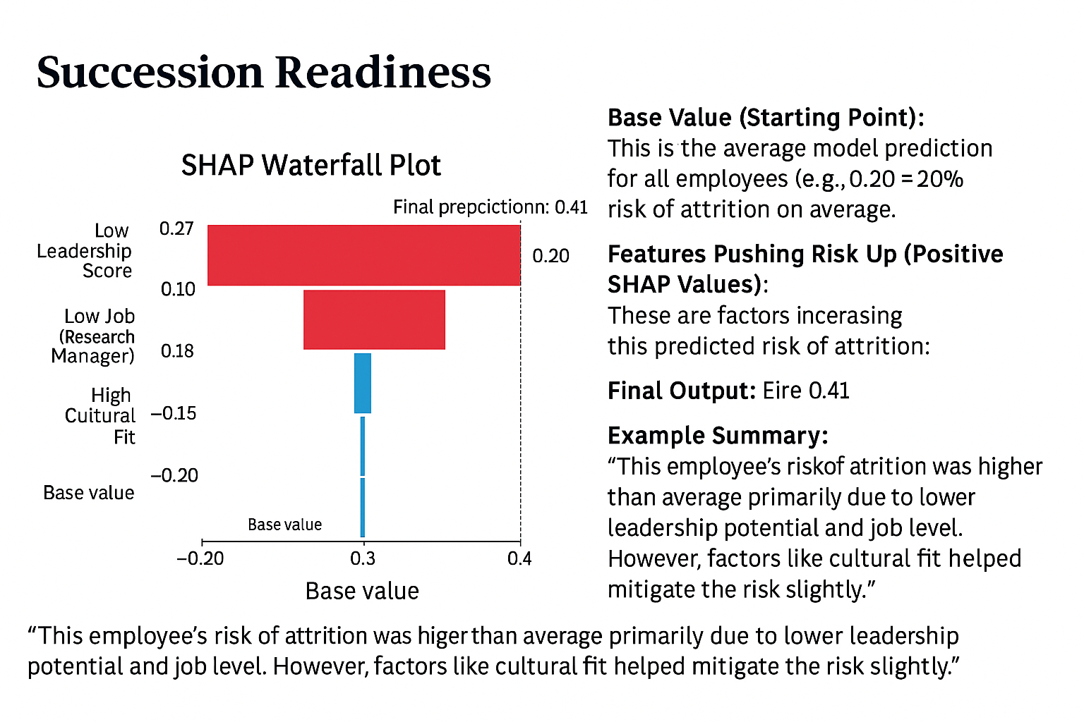
📈 Final Prediction: 0.41 (or 41%)
So, even though the average is 20%, this employee's individual prediction is 41% risk of attrition.
That’s due to low leadership potential and low job level, even though cultural fit helped reduce it a little.
"The model predicted a 41% chance that this employee may leave. The biggest reasons were their low leadership score and lower job level. However, the employee's strong cultural fit slightly reduced the risk. This insight helps HR teams understand why someone might leave — and how to intervene."
Notes:
“Although this employee travels frequently and has lower work-life balance, their high leadership score, stable job role, and high potential rating help reduce the overall attrition risk to 34% — still higher than average but manageable.”

Slide 19
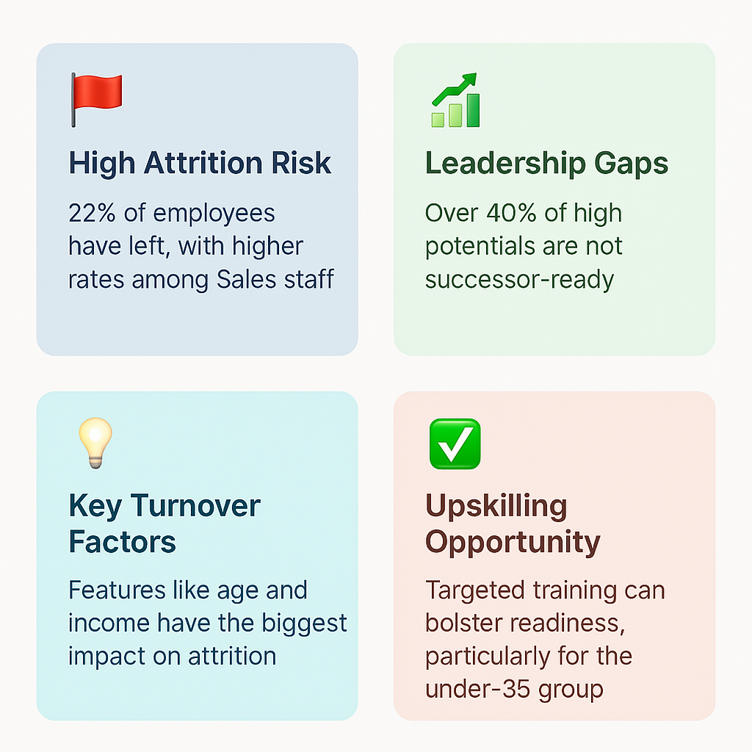
Future Recommendations
Identify Key Sucessors and work on Individual Development Plans
Prepare further models for Career Pathing, Learning & Development
Design Customiyed Self driven Workforce Planning, Gap Filling, Learning & Developing.

